Slide 1


Lesson 4 Famous explorers
UNIT 2

Slide 2
Play the association game.
C
D
A
B
France
Europe
the Thames
Rome
Great Britain
Africa
the Danube
Paris
Italy
Australia
the Sava
London
Croatia
Asia
the Amazon
New York
COUNTRIES
CONTINENTS
RIVERS
TOWNS/CITIES
GEOGRAPHY

Slide 3
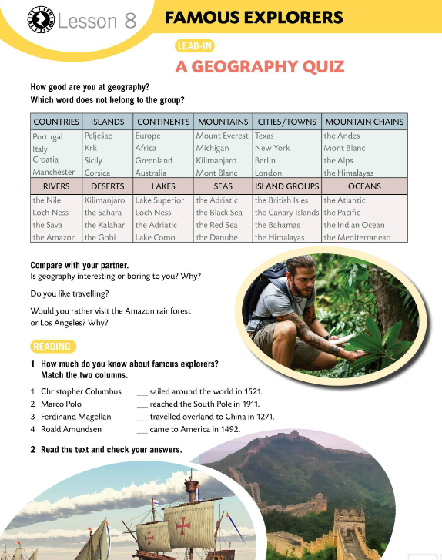
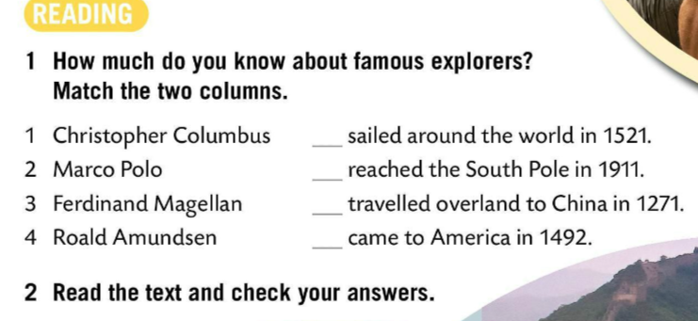
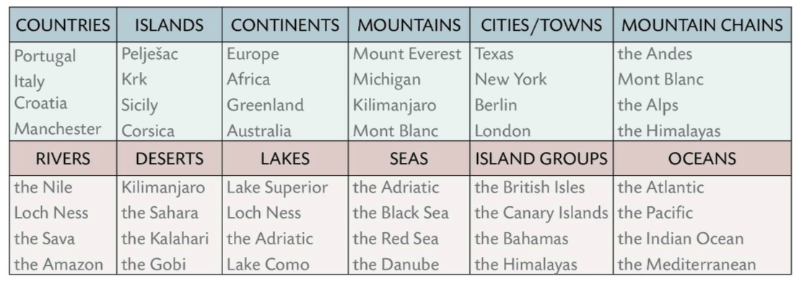
How good are you at geography? Which word does not belong to the group?
Check.
Compare it with your partner.
Is geography interesting or boring to you? Why?
Do you like travelling?
Would you rather visit the Amazon rainforest or Los Angeles? Why?
How much do you know about famous explorers? Match the two columns. Read the text and check your answers.

Slide 4
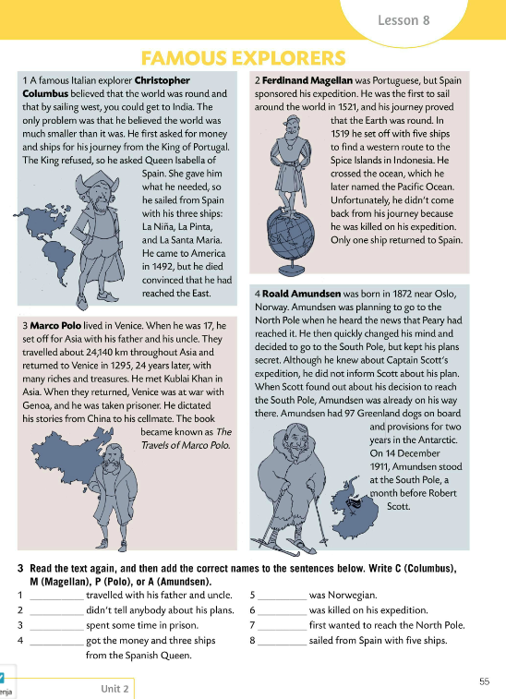
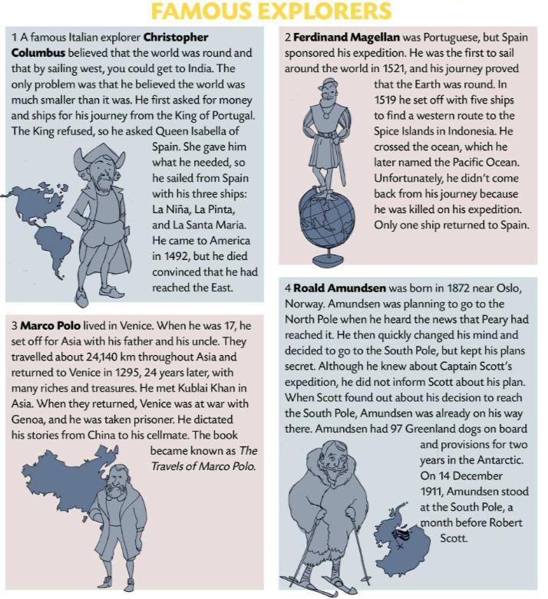
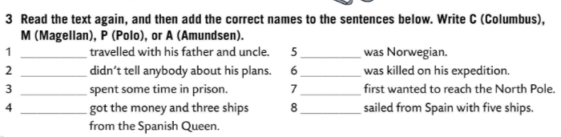

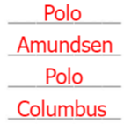
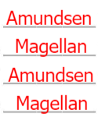
Read the text. Check Task 1.
Check.
Read the text again. Add the correct names to the sentences below.
Write C (Columbus), M (Magellan), P (Polo), or A (Amundsen).
Check.
Play a quiz.
https://wordwall.net/play/848/412/183

Slide 5
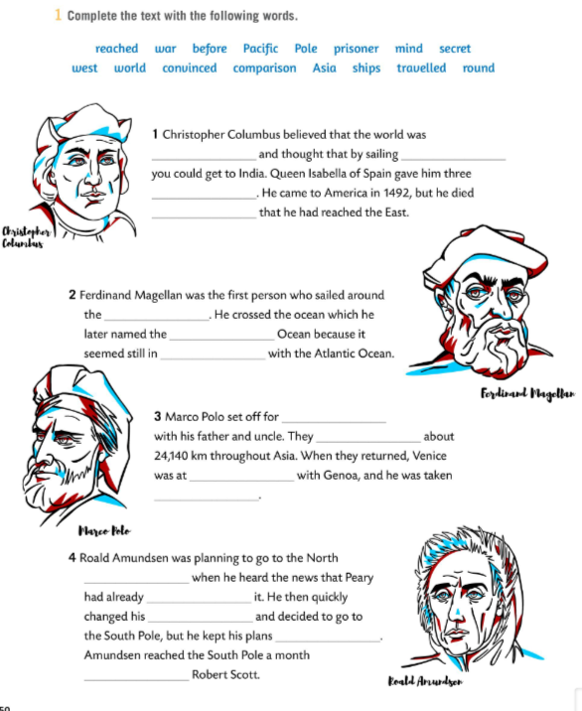
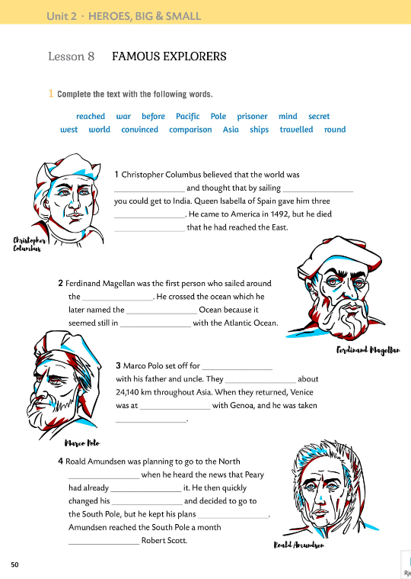

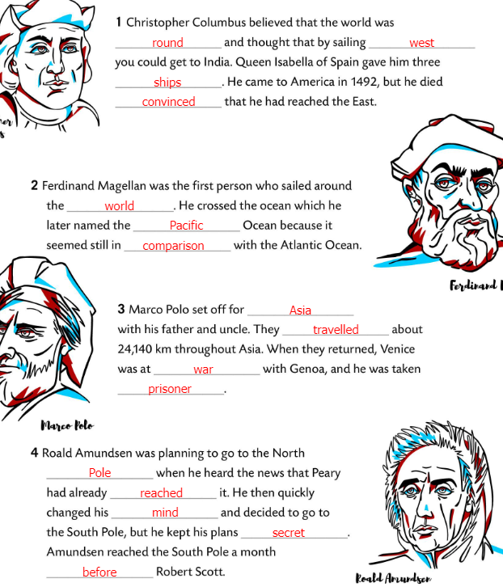
Workbook, p. 50
Complete the text with the words in Task 1.
Check.

Slide 6
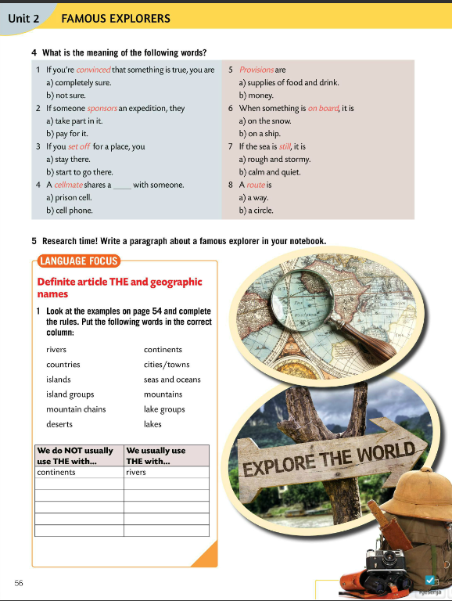
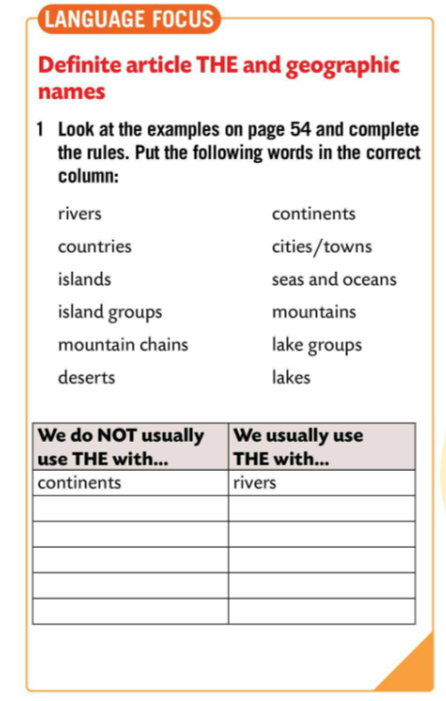
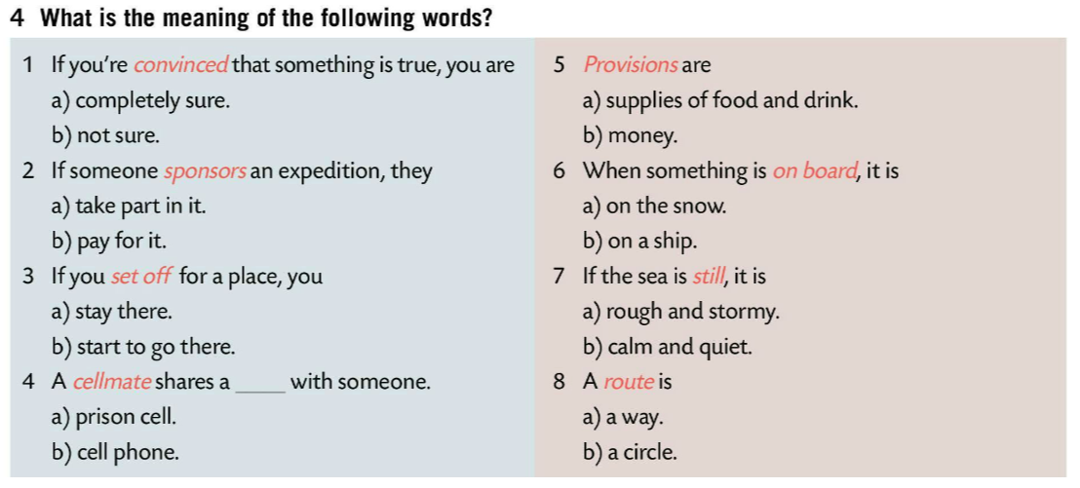
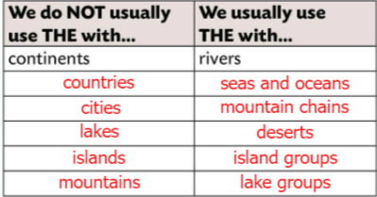
What is the meaning of the following words?
Check. Copy words and their meanings.
Research time!
Write a paragraph about a famous explorer.
LANGUAGE BOX
Look at the examples. Complete the rules in Task 1.
Put the following words in the correct column.
Check.

Slide 7
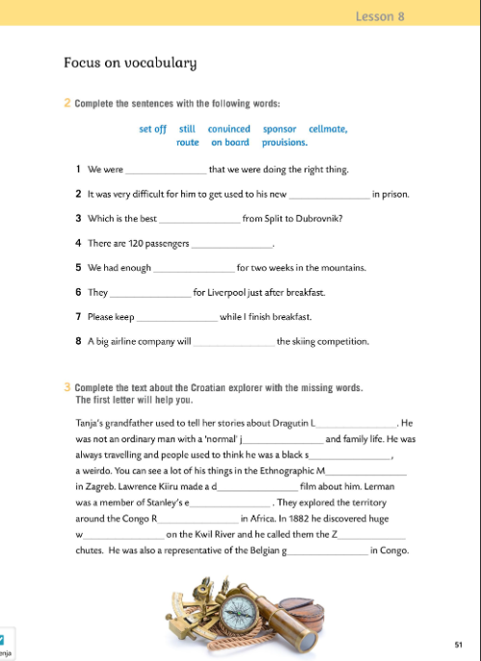
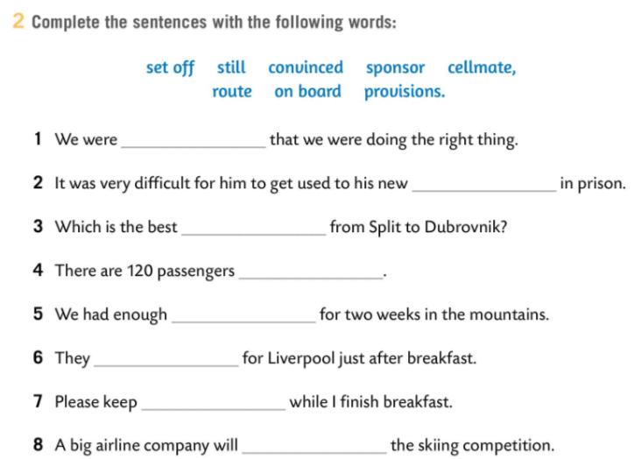
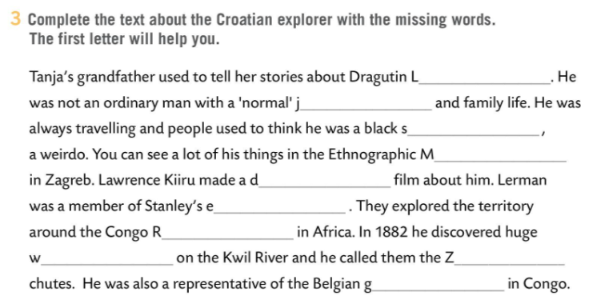
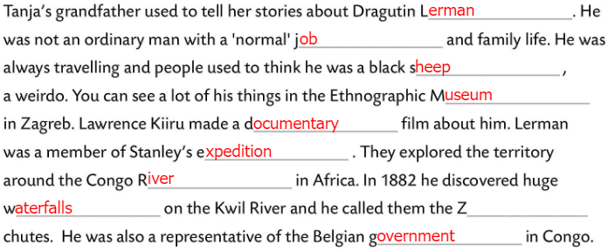
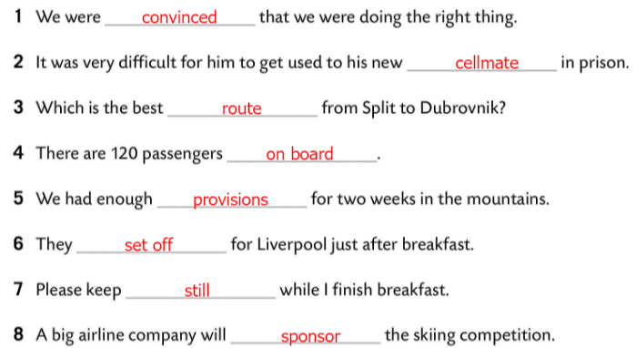
Workbook, p. 51
Complete the text with the words in Task 2.
Check.
Complete the text about the Croatian explorer with the missing words. The first letter will help you.
Check.

Slide 8
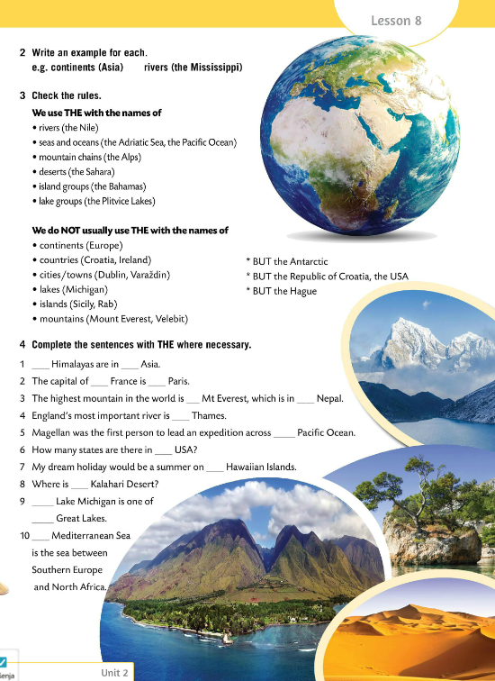
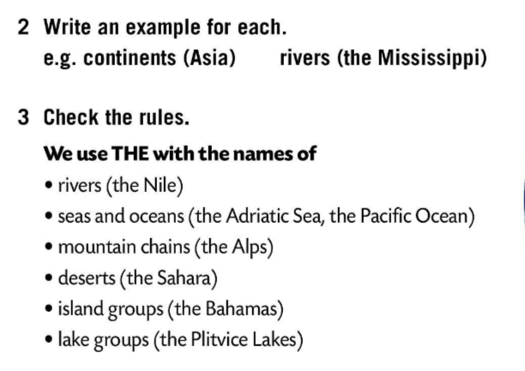
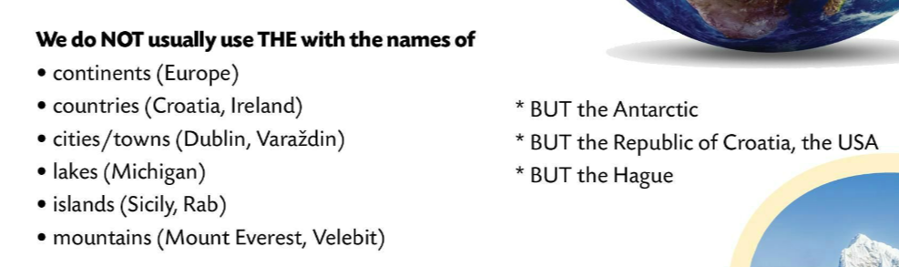
Write an example for every group of words.
Check in class.
CHECK THE RULES
THE – names of:
rivers, seas and oceans,
mountain chains, deserts
island groups and lake groups.
Član THE koristimo u imenima rijeka, mora, oceana, planinskih lanaca, pustinja, skupine otočja i skupine/grupe jezera.
We DO NOT use THE with the names of
continents,
countries,
cities/towns,
lakes,
islands,
mountains.
Član THE ne koristimo u nazivima kontinenata, zemalja, gradova, jezera, otoka, planina.
BUT
the Antarctic
the Republic of Croatia,
the USA
the Hague

Slide 9
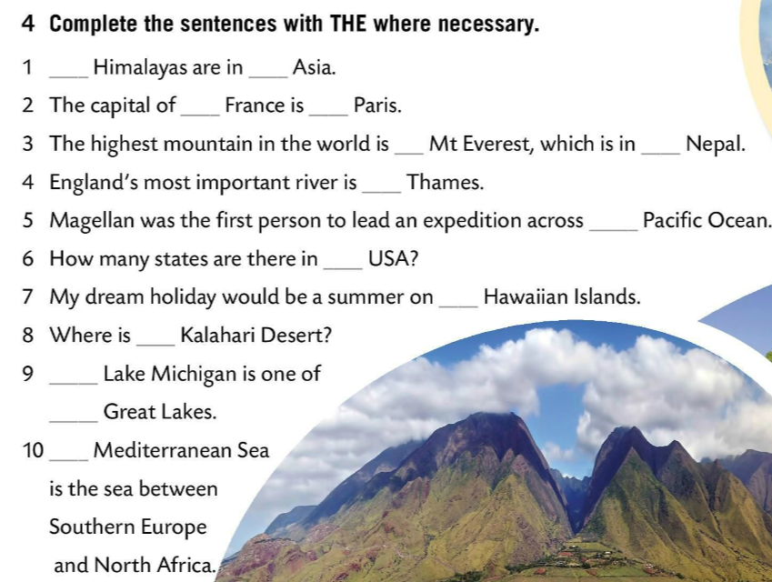
Complete the sentences with THE where necessary.
The
-
-
-
-
-
Check.
THE
THE
THE
THE
THE
-
THE
THE
Time to practice. Choose definite or zero article.
https://learningapps.org/watch?v=pdvuaek4n20

Slide 10
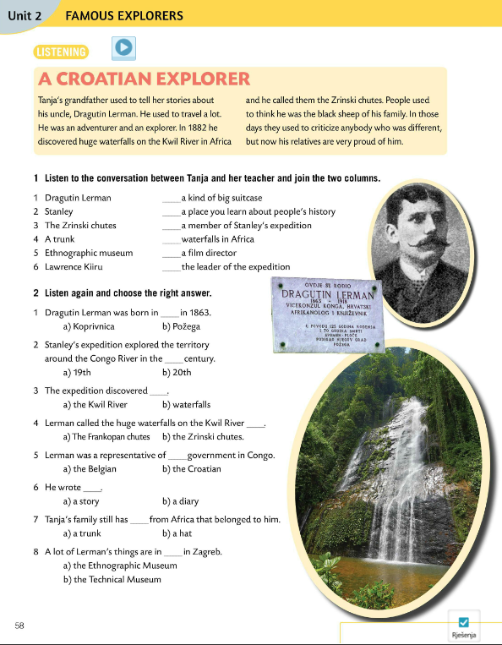
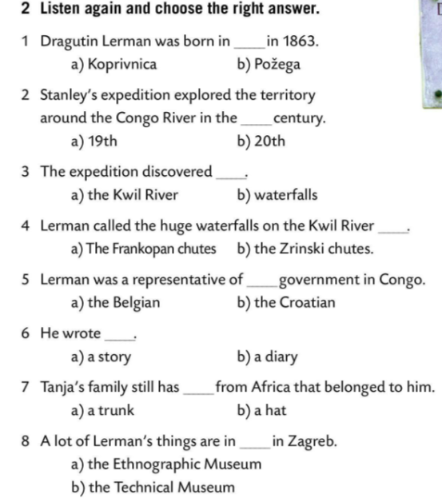
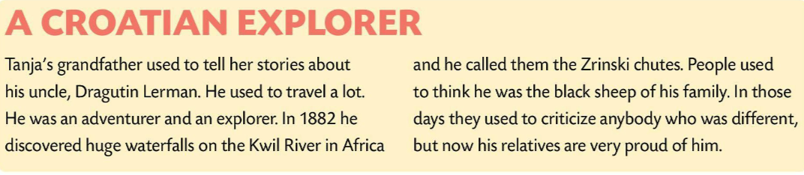

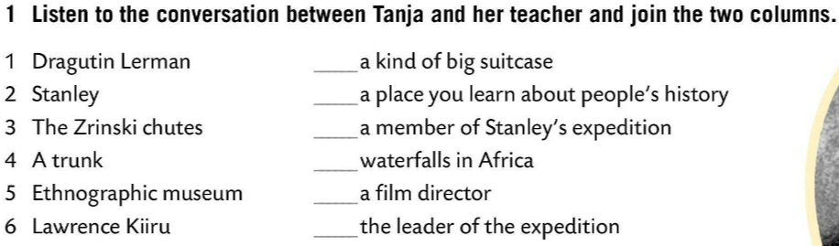
Read the short introduction.
Listen to the conversation between Tanja and her teacher.
Join the two columns.
Check.
4
5
1
3
6
Listen again and choose the right answer.
2
Check.

Slide 11
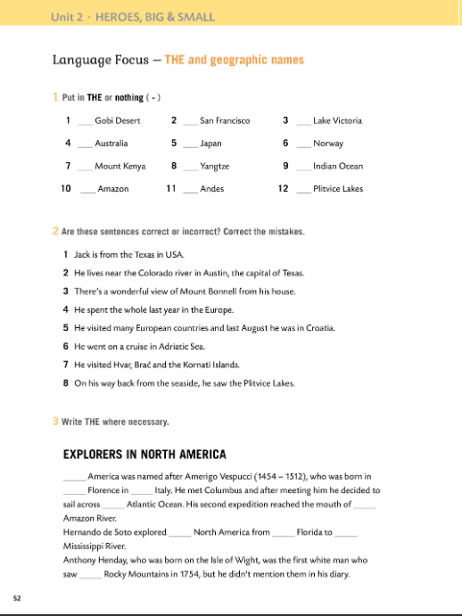
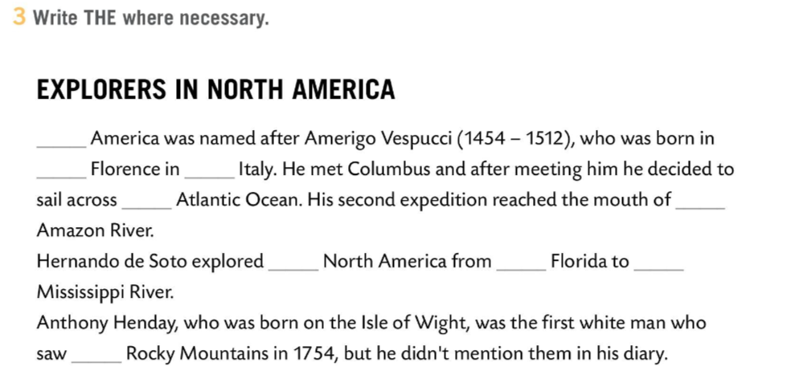
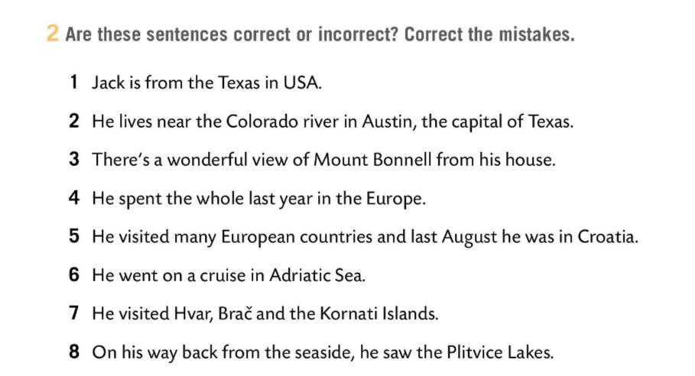
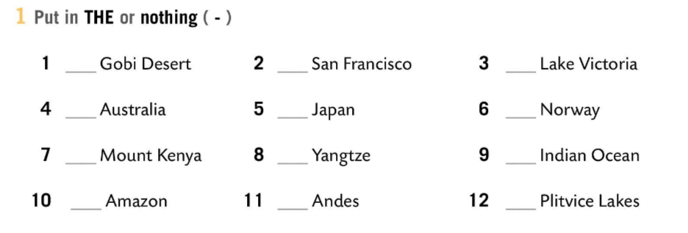
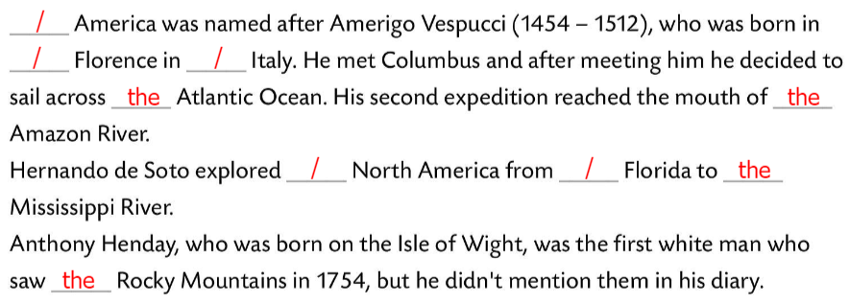
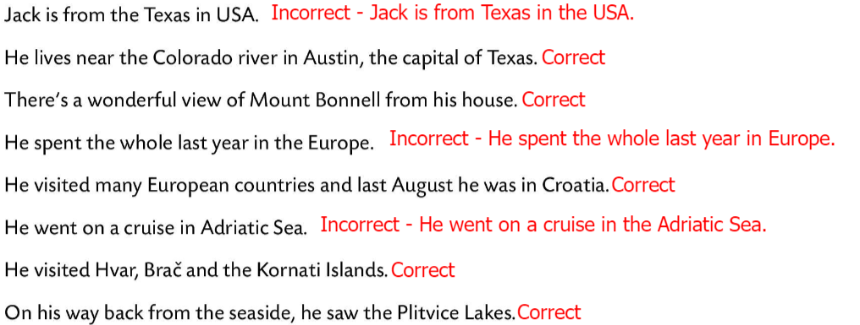
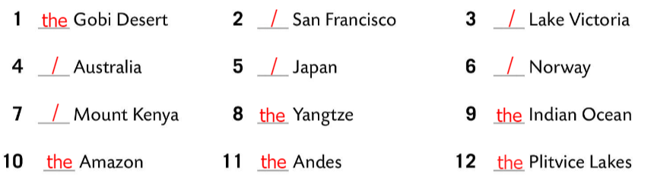

Workbook, p. 52
Put in THE or nothing (-).
Check.
Are these sentences correct or incorrect? Correct the mistakes.
Check.
Write THE where necessary.
Check.

Slide 12
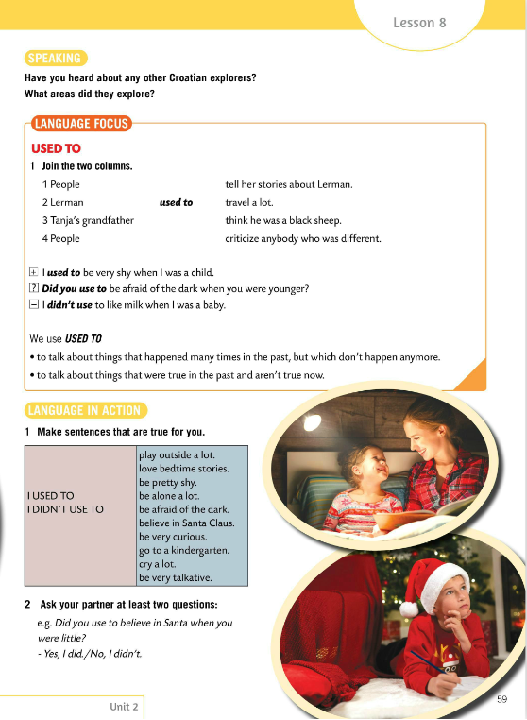
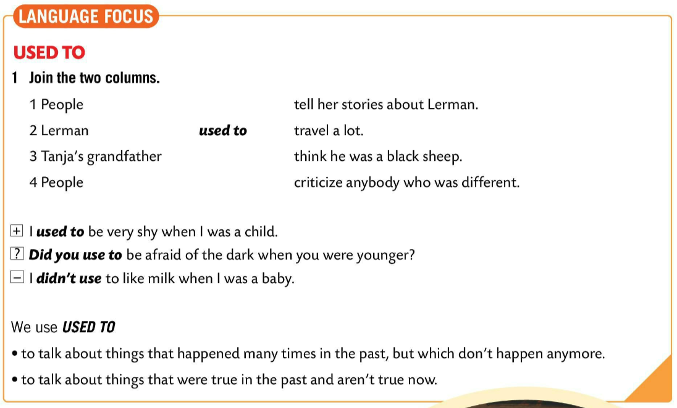
Have you ever heard about any other Croatian explorers?
What areas did they explore?
LANGUAGE FOCUS
Task 1 - join the two columns.
We use USED TO to talk about things that happened many times in the past, but which don’t happen anymore.
USED TO je izraz koji koristimo kada govorimo o nečemu što se događalo ili je bilo u prošlosti učestalo, ALI se više ne događa.
We use USED TO to talk about things that were true in the past and aren’t true now.
USED TO koristimo kada govorimo o nečemu što je u prošlosti bilo istina, ali više nije.

Slide 13
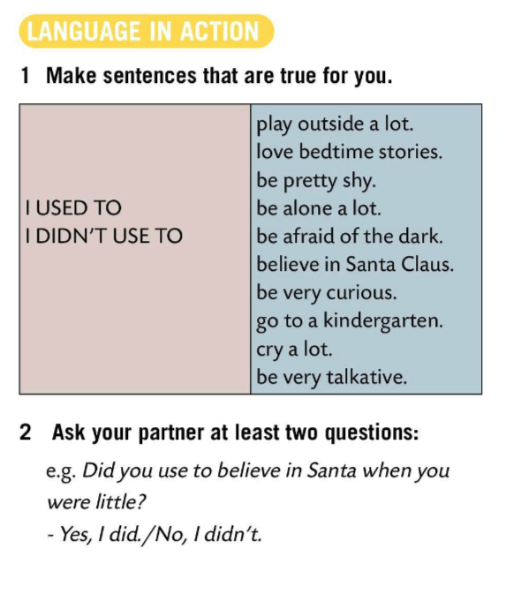
Make sentences that are true for you.
Write at least two sentneces.
Ask your partner at least two questions.

Slide 14
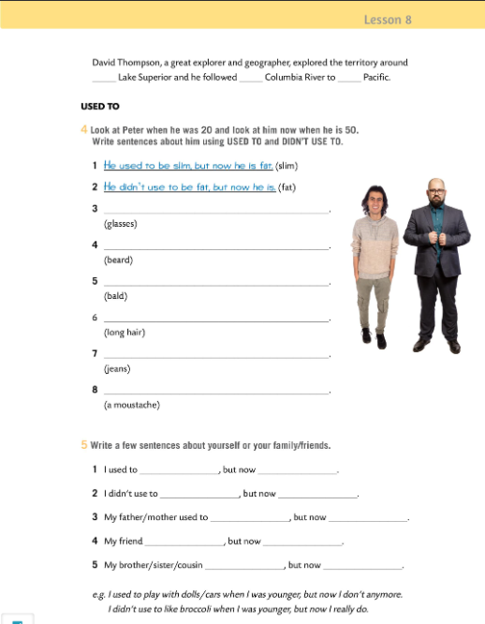
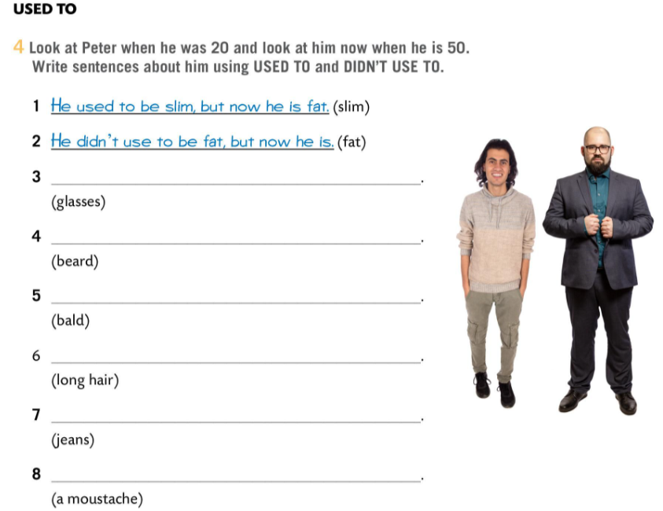
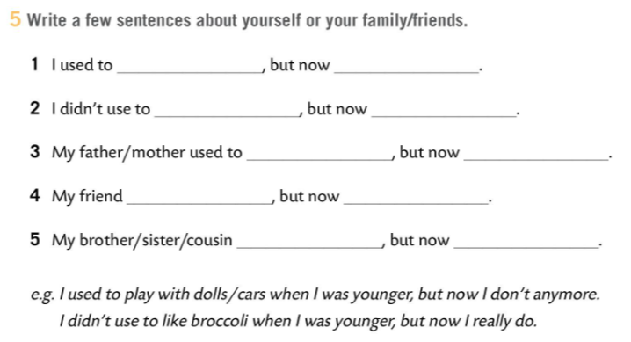
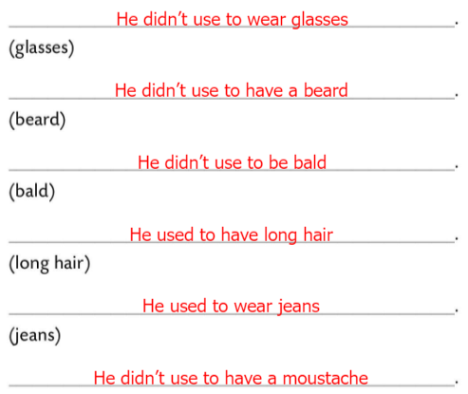
Workbook, p. 53
Look at Peter when he was 20 and look at him now when he is 50. Write sentences about him using USED TO and DIDN’T USE TO.
Check.
Write a few sentences about yourself.

